Slide 1
Process Map Template
[Title]
[Workstream Owner]
START
[Workstream Owner]
[Workstream Owner]

Slide 2
Process Map Shape Repository
Process
START
END
Decision

Slide 3
Instructions
How do we apply Current State Process Mapping?
1. Create a cross-functional team of employees from a wide range of positions within the organization. Decide scope of current state to be mapped.
2. Develop the Current State Process Map by breaking down each operation into specific tasks. Draw out this process as a team.
  Go to Deckplate, the place of value
  Observe current state, document steps, timings, flows
  Document a visual depiction (process map) of how the “thing” (e.g., information, material, work order, person) travels through the sequence
  Develop preliminary hypotheses for future state improvements

Slide 4
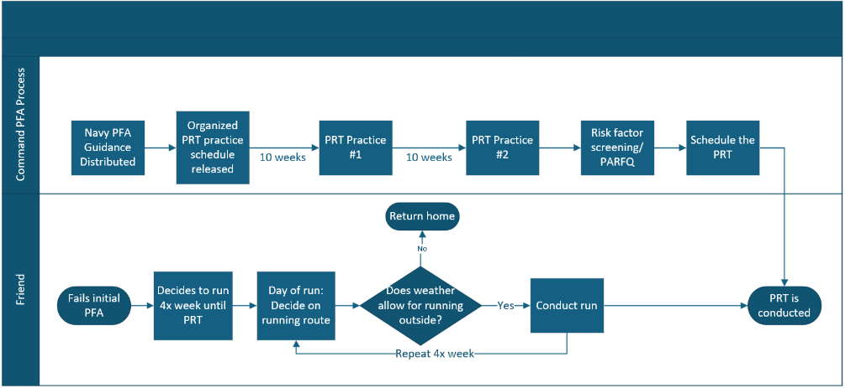
Process Map Example
Notes:
Option 1 – Not in FELIX

